Slide 1


Brandon Beddes
11/11/2022

Slide 2

Outline
Executive Summary
Introduction
Methodology
Results
Conclusion
Appendix

Slide 3
Executive Summary
Summary of methodologies
Data Collection
Data Wrangling
Exploratory Data Analysis with Data Visualization
Exploratory Data Analysis with SQL
Building an interactive map with Folium
Building a dashboard with Plotly Dash
Predictive Analysis
Summary of all results
Exploratory Data Analysis Results
Interactive Analytics demo
Predictive analysis results

Slide 4
Introduction
Project background and context
Trying to compete with SpaceX. We looked into the available information to try to learn what we can about how the first stage of the rocket is successful or fails.
Problems you want to find answers
Is it possible to determine if the first stage of the rocket will land successfully or not, by using data science instead of rocket science.

Slide 5

Section 1

Slide 6
Methodology
Executive Summary
Data collection methodology:
Data was collected by web scrapping
Perform data wrangling
We first filtered the data, by getting rid of all Falcon 1 launches
We dealt with any missing values
Perform exploratory data analysis (EDA) using visualization and SQL
Perform interactive visual analytics using Folium and Plotly Dash
Perform predictive analysis using classification models
Built, tuned and evaluated classification models to ensure the best results

Slide 7
Data Collection
Data was collected by using webscrapping to find available information about the launches that SpaceX has completed.
By using both of these methods we were able to get the information we needed to complete this analysis.

Slide 8
Data Collection – SpaceX API
I used a get requestions to call the SpaceX data, then cleaned the data.
API Github
Used Get request
Used static response for JSON
Decoded response and turned into a pd dataframe
Constructed Dataset & Combined columns into Dict
Filtered to include only Falcon 9 Launches
Delt with Missing Values

Slide 9
Data Collection - Scraping
We applied webscrapping to get the falcon 9 launch records using BeautifulSoup
Web scraping lab
Used Web scrapping to Gather information
Using Python we decoded the response into a .JSON
Replaced missing values w/.mean()
Created a dataframe from the dictionary
Then filitered to only include Flacon 9 Launches
Constructed data we have into a dictionary
Exported to a CSV
9

Slide 10
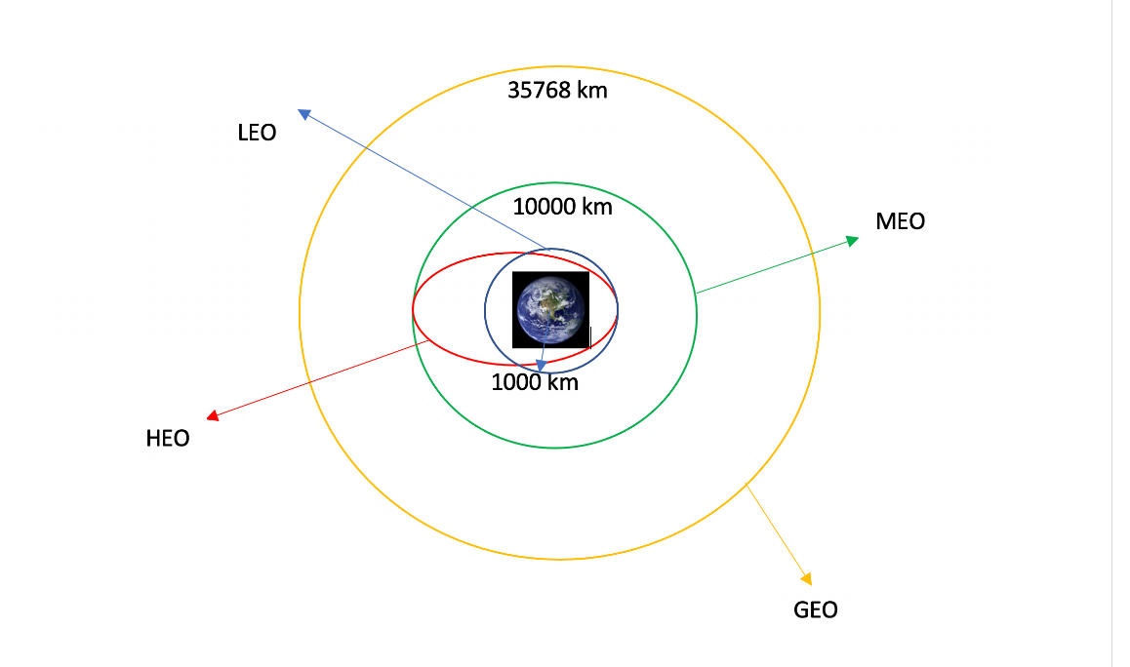
Data Wrangling
The data was processed by seeing what our calls were returning, then determining what cleaning up needed to be done, such as dealing with null values, or any extra data that was being brought in.
Lab for Data Wrangling
Calculated the percentage of missing values for each attribute
Calculated number of launches on each site
Calculated number and occurrence of each orbit
Calculated number and occurrence of mission outcome per orbit type
5) Created landing outcome label from outcome column

Slide 11
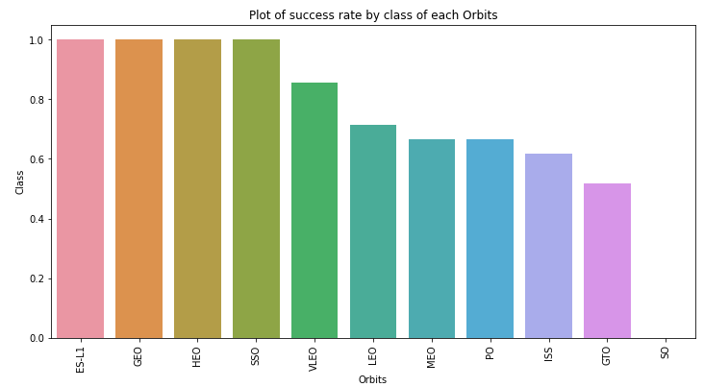
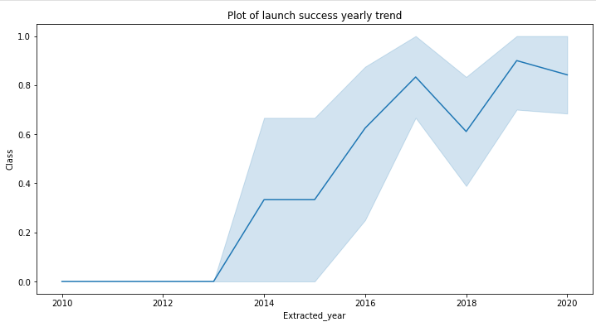
EDA with Data Visualization
The bar chart we created showed the Success by the different Orbits
The line chart showed the launch success by year
EDA with data visualization notebook

Slide 12
EDA with SQL
We recalled the each of the unique launch sites
We go the launch sites that begin with the string CCA
We got the total payload mass carried by boosters launched by NASA
Got the average payload mass
Found date for first successful landing outcome in ground pad achieved
Listed name of boosters which have success in drone ship and have payload mass greater than 4000 but less than 6000
Got the total number of successful and failure mission outcomes
Got names of the booster_versions which have carried the maximum payload mass.
Got failed landing_outcomes in drone ship, their booster versions, and launch site names for in year 2015
Got the count of landing outcomes (such as Failure (drone ship) or Success (ground pad)) between the date 2010-06-04 and 2017-03-20, in descending order
EDA with SQL notebook

Slide 13
Build an Interactive Map with Folium
We got all the launch sites, and added map objects such as markers, circles, and lines to mark the success or failure of each launch.
We changed the launch outcomes to class 0 or 1.
Using the Color-labeled marker clusters identified which sites have high success rates
Calculated the distance between the launch site to its proximities.
Interactive Github

Slide 14
Build a Dashboard with Plotly Dash
I built an interactive dashboard with plotly dash
Created pie charts showing total launches by each site
Created a scatter graph showing the relationship with outcome and payload mass for the different booster version

Slide 15
Predictive Analysis (Classification)
Using Numpy and padas we transformed the data and then split our data ito training and testing
I then build a machine learning models and tuned different hyperparameters using GridSearchCV
Then using accuracy I improved the model using feature engineering and algorithm tuning.
predictive analysis lab

Slide 16
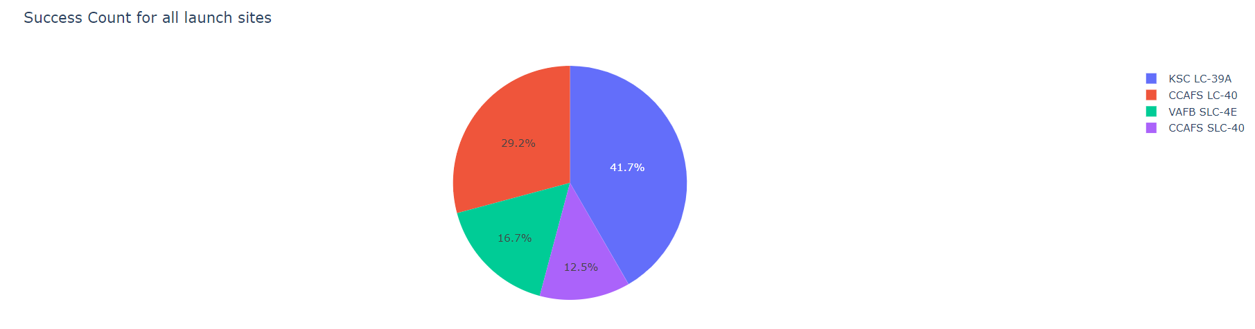
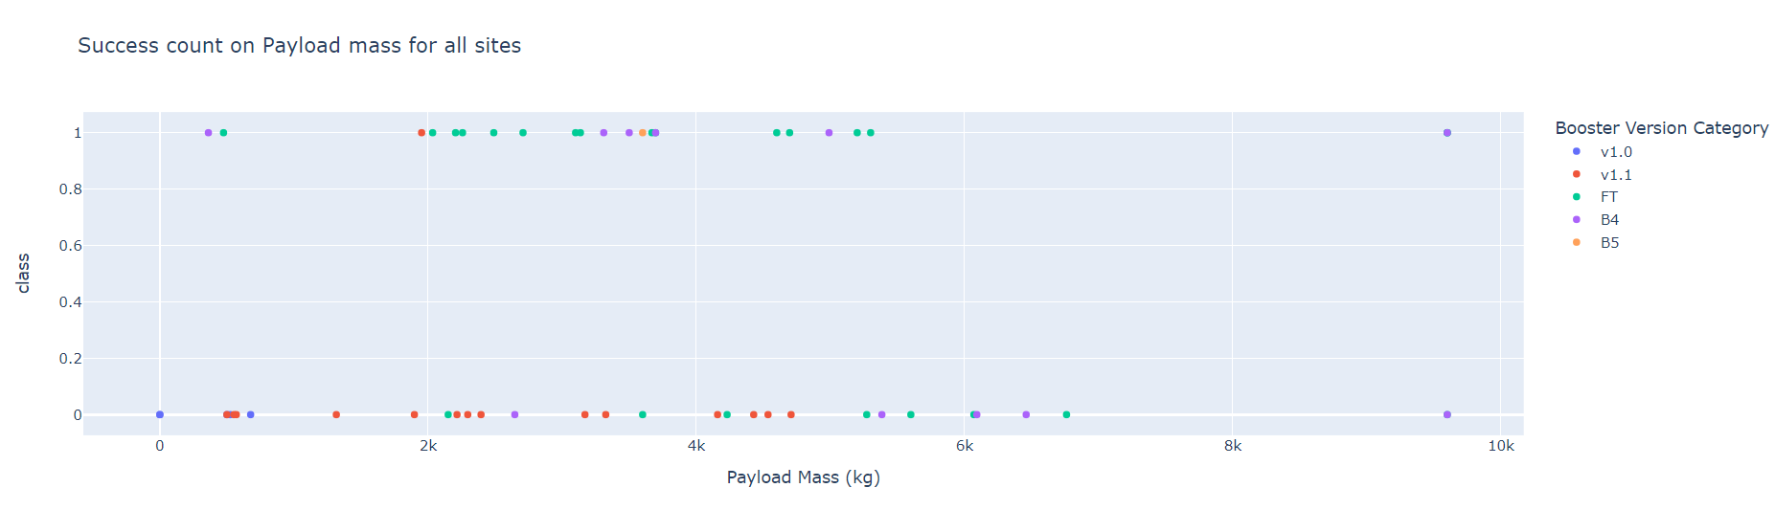
Results
Exploratory data analysis results
Interactive analytics demo in screenshots
Predictive analysis results

Slide 17

Section 2

Slide 18
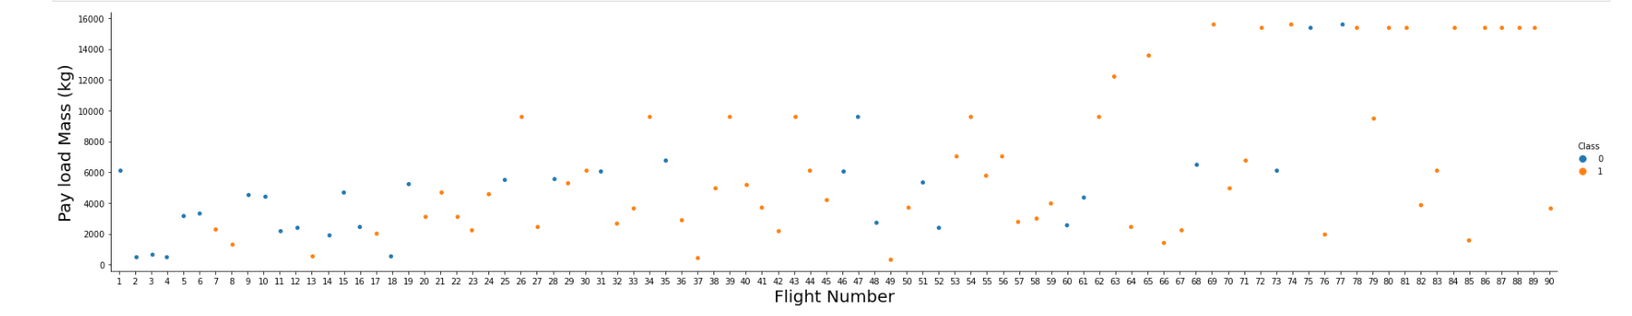
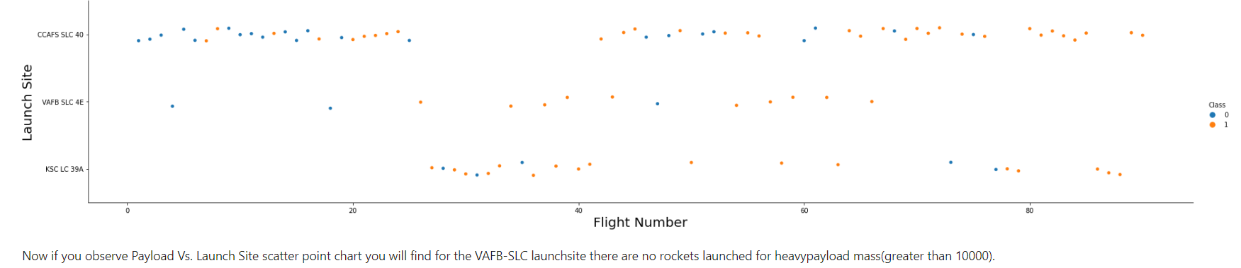
Flight Number vs. Launch Site
Show a scatter plot of Flight Number vs. Launch Site
Show the screenshot of the scatter plot with explanations

Slide 19
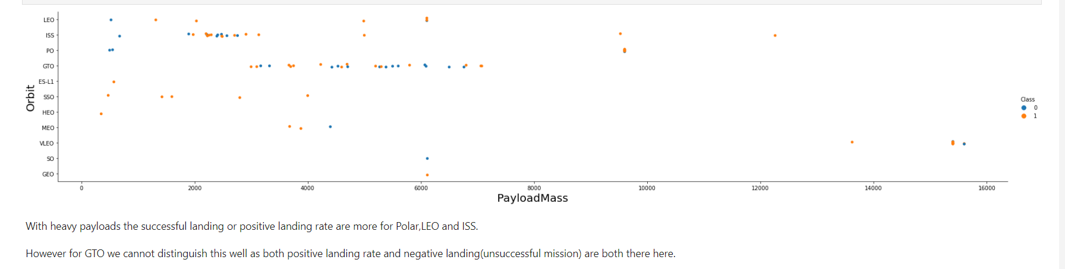
Payload vs. Launch Site
Show a scatter plot of Payload vs. Launch Site
Show the screenshot of the scatter plot with explanations

Slide 20

Success Rate vs. Orbit Type
Show a bar chart for the success rate of each orbit type
Show the screenshot of the scatter plot with explanations

Slide 21
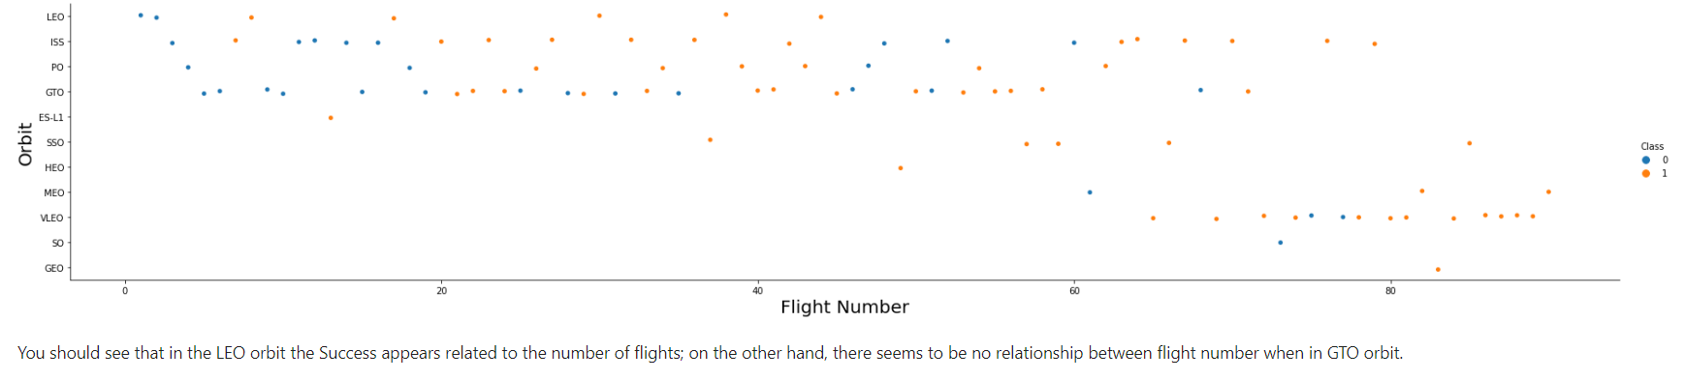
Flight Number vs. Orbit Type
Show a scatter point of Flight number vs. Orbit type
Show the screenshot of the scatter plot with explanations

Slide 22
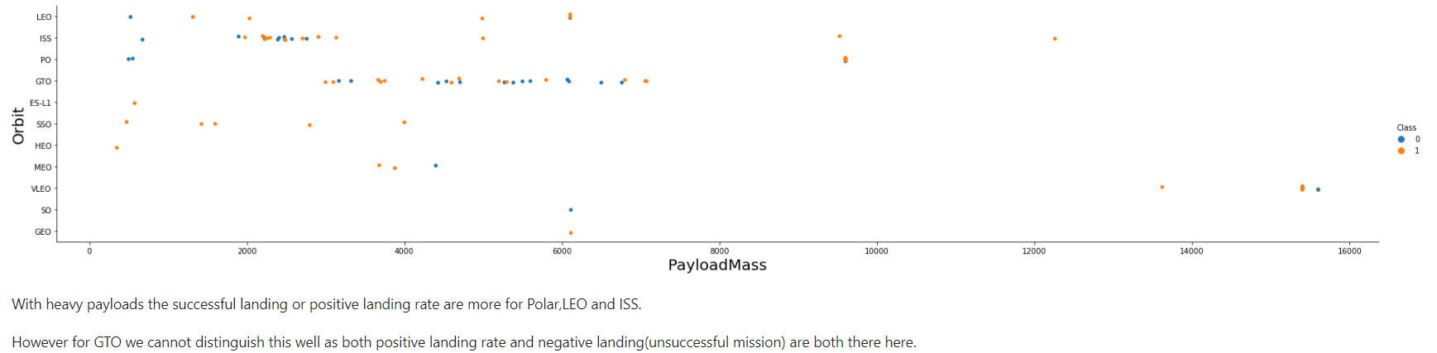
Payload vs. Orbit Type
Show a scatter point of payload vs. orbit type
Show the screenshot of the scatter plot with explanations

Slide 23
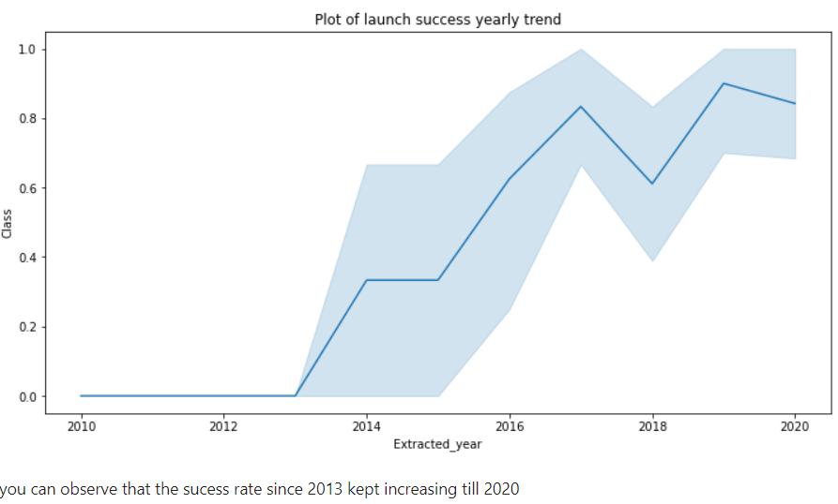
Launch Success Yearly Trend
Show a line chart of yearly average success rate
Show the screenshot of the scatter plot with explanations

Slide 24
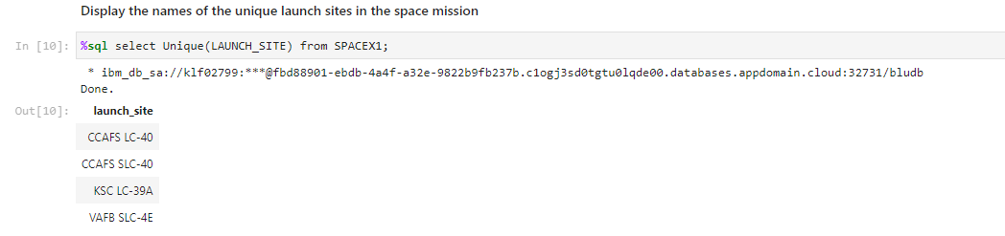
All Launch Site Names
I used the Unique call to find the launch sites

Slide 25
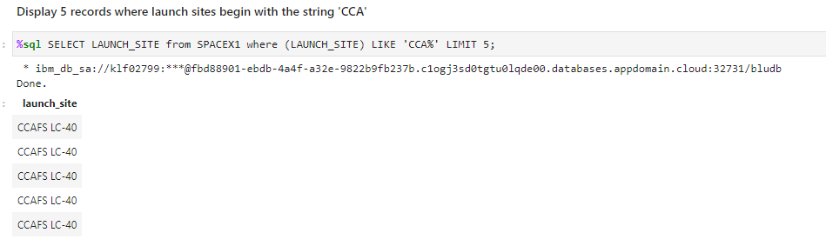
Launch Site Names Begin with 'CCA'
I found the records of 5 instances where launch site contained CCA

Slide 26
Total Payload Mass
Calculate the total payload carried by boosters from NASA
Present your query result with a short explanation here

Slide 27
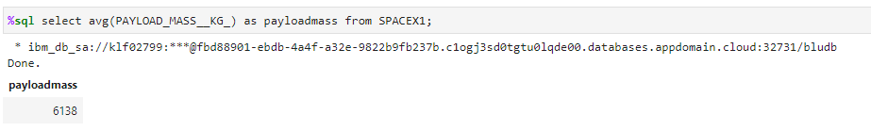
Average Payload Mass by F9 v1.1
I found the average payload mass for the F9

Slide 28
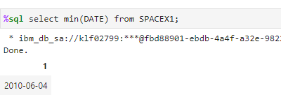
First Successful Ground Landing Date
I found the minimum date which displayed the first successful landing

Slide 29
Successful Drone Ship Landing with Payload between 4000 and 6000
List the names of boosters which have successfully landed on drone ship and had payload mass greater than 4000 but less than 6000
Present your query result with a short explanation here

Slide 30
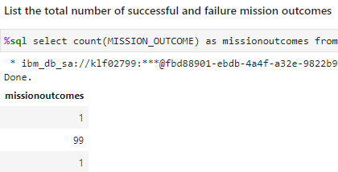
Total Number of Successful and Failure Mission Outcomes
I counted the successful missions 99 and the failure missions 1

Slide 31
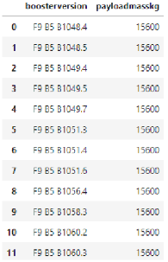
Boosters Carried Maximum Payload
Selected the max payload by booster version

Slide 32
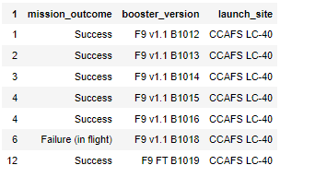
2015 Launch Records
In 2015 there were 6 successful and 1 failure
Present your query result with a short explanation here

Slide 33
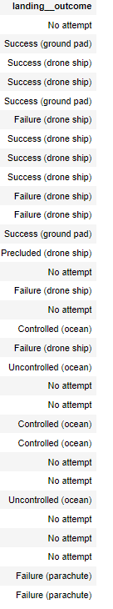
Rank Landing Outcomes Between 2010-06-04 and 2017-03-20
Here is the output for landing outcomes between 6/4/2010 to 3/20/17

Slide 34

Section 3

Slide 35
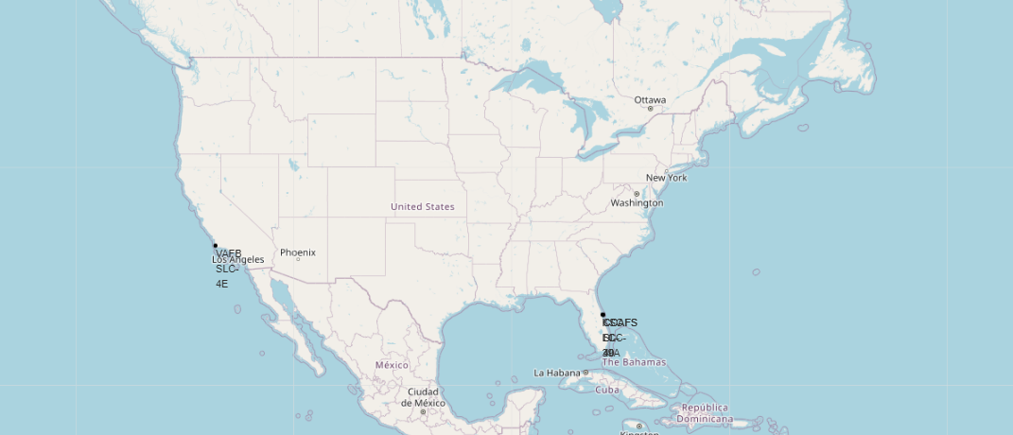
SpaceX Launch Sites
SpaceX launches from sites that are in Florida and California
Explore the generated folium map and make a proper screenshot to include all launch sites’ location markers on a global map
Explain the important elements and findings on the screenshot

Slide 36
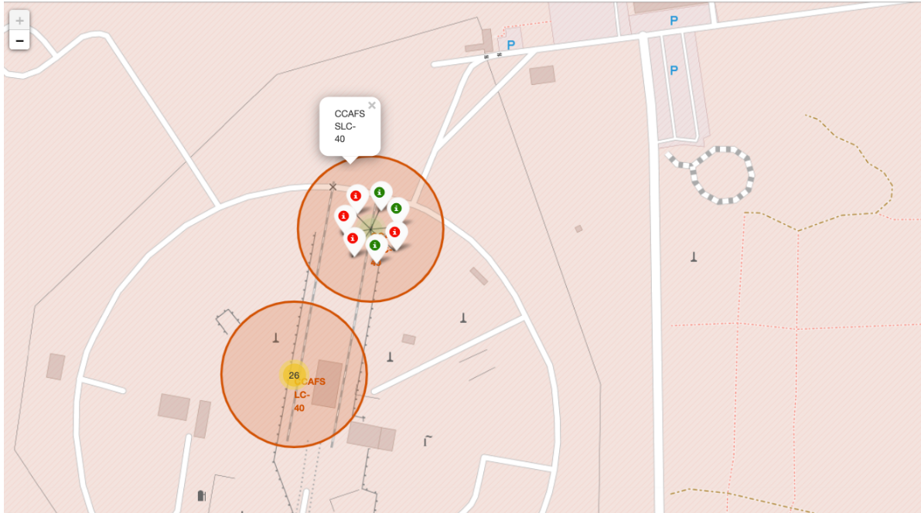
Florida Launch Sites
Green Marker shows successful launches, Red shows failure
Explore the folium map and make a proper screenshot to show the color-labeled launch outcomes on the map
Explain the important elements and findings on the screenshot

Slide 37
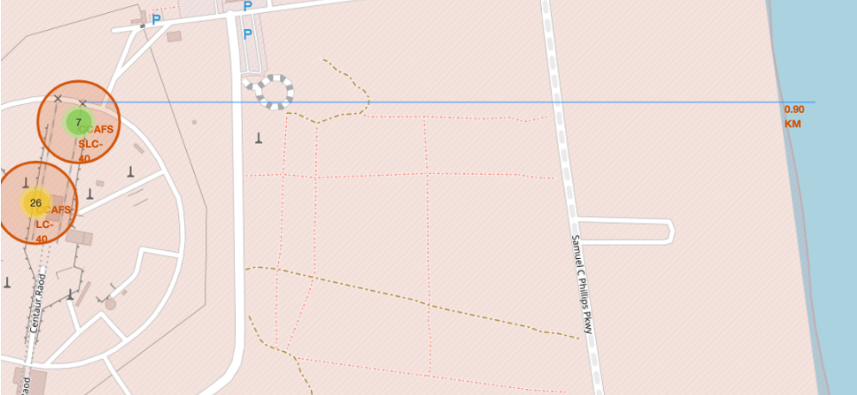
Launch Site locations
There are different elements in this screenshot such as railways and Highways that all can affect launch sites.

Slide 38

Section 4

Slide 39
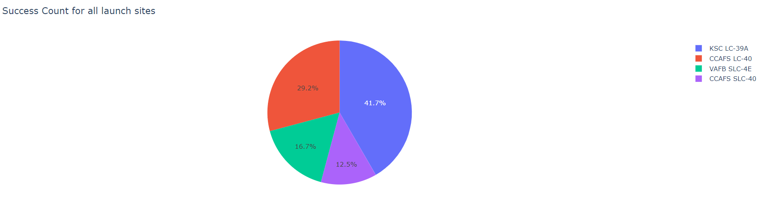
Successful Launch sites
This chart shows that the most successful launch site is KSC LC-39A

Slide 40
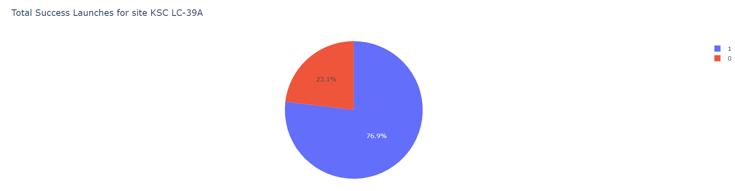
KSC LC-39A Success rate
This pie chart is showing the success rate for this particular site.

Slide 41
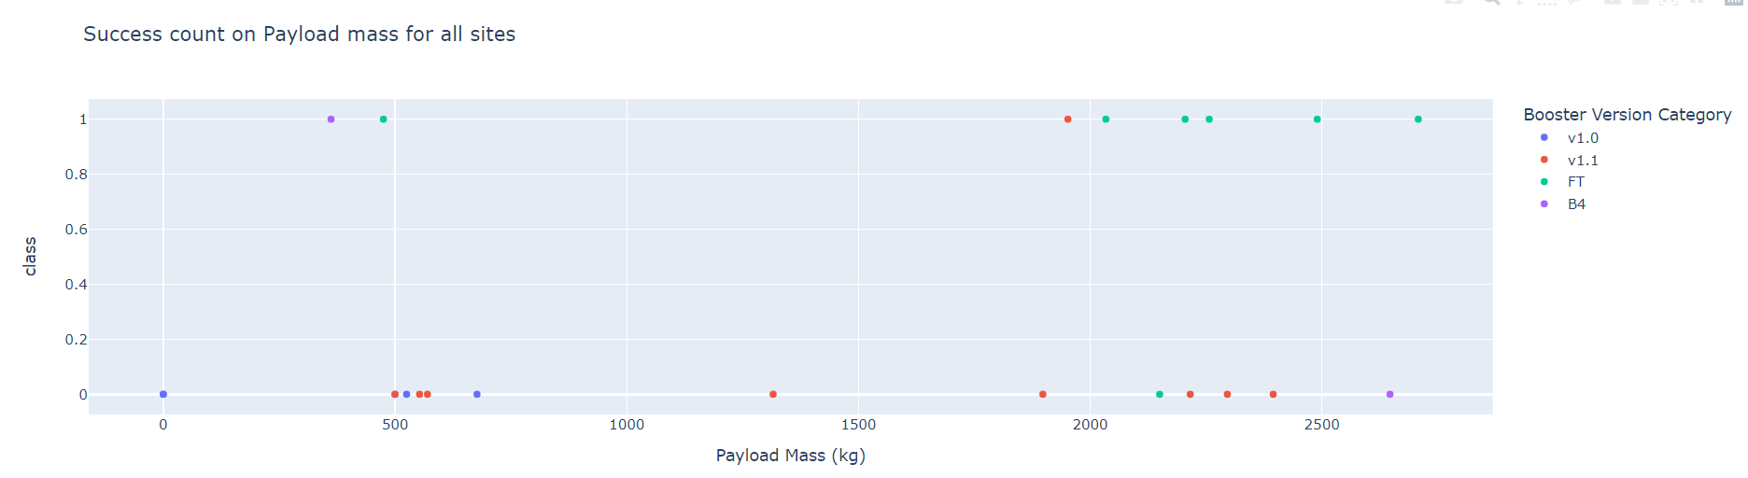
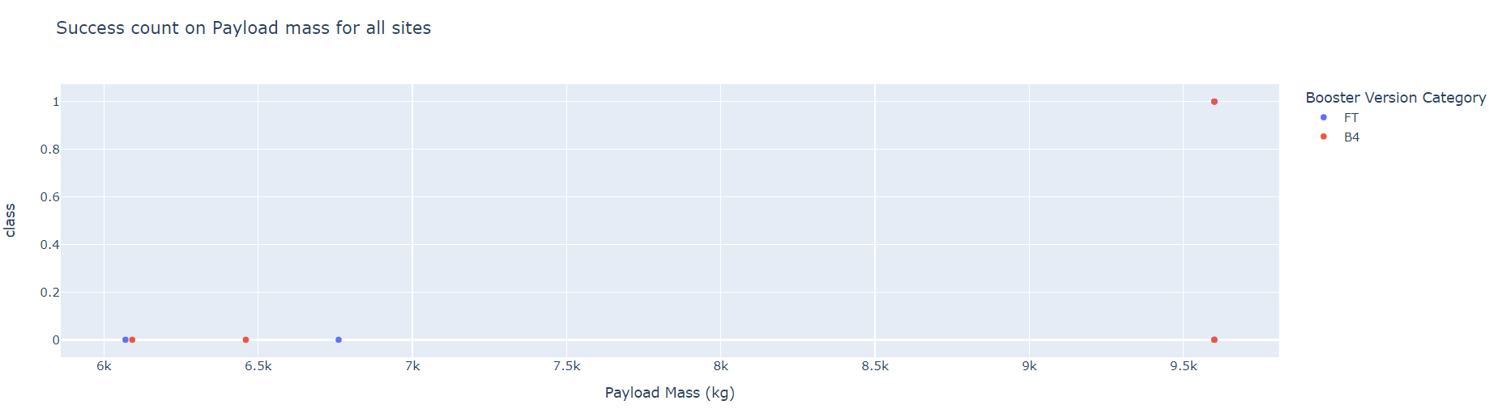
Plots successful launch by Mass
Replace <Dashboard screenshot 3> title with an appropriate title
Show screenshots of Payload vs. Launch Outcome scatter plot for all sites, with different payload selected in the range slider
Explain the important elements and findings on the screenshot, such as which payload range or booster version have the largest success rate, etc.

Slide 42

Section 5

Slide 43
Classification Accuracy
The best model is DecisionTree

Slide 44
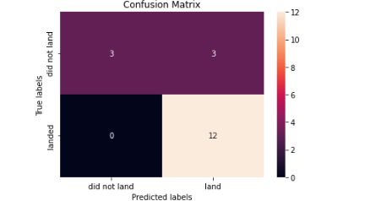
Confusion Matrix
The confusion matric for the decision tree classifier is showing that the classifier can distinguish between the different classes.

Slide 45
Conclusions
Point 1
Point 2
Point 3
Point 4
…

Slide 46


